Slide 1
Employee Data Analysis using Excel
STUDENT NAME REGISTER NO DEPARTMENT COLLEGE
: A.Ameer abbas
:312202191 (B59D1F600F60C7DB1034349D3220E2DA)
: commerce
: Mohammed sathak college of arts and science

Slide 2
PROJECT TITLE
Employee Performance Analysis using Excel

Slide 3


AGENDA
Problem Statement
Project Overview
End Users
Our Solution and Proposition
Dataset Description
Modelling Approach
Results and Discussion
Conclusion
3/21/2024 Annual Review

Slide 4

PROBLEM STATEMENT
A large dataset of employee information in Excel, including personal details, job roles, performance metrics, and attendance records. Despite having this data, we face challenges in efficiently analyzing and leveraging this information for decision-making.

Slide 5

PROJECT OVERVIEW
It is a summary of employee dataset analysis the employees salary package defined with basic pay with allowance and deductions usually monthly pay for current working employees based on their designation. performance analysis in order to check the trains and different categories like high medium low performance level of the employees

Slide 6
Dataset Description
Employee dataset – salaypackage Employee ID - ASUM123 TO ASUM 948.
Name – Text
Performance Level – Very High , High , Medium , Low Gender – Male , Female

Slide 7
MODELLING
DATA collEcTIoN : 1). Name
Employee UID Desination pay
allowance
deductions
Net salary
2).
3).
4). Basic
PERFORMANCE LEVEL :
1). Very high | 2).
High | 3).
Medium | 4).
Low

Slide 8





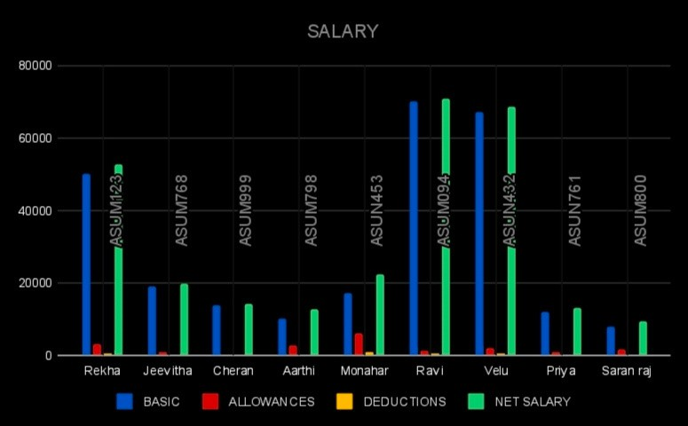
RESULTS
Active Future Start Leave of Absence
Terminated for Cause
Voluntarily Terminated
300.0
250.0
200.0
150.0
100.0
50.0
0.0
BPC
CCDR
EW
MSC
NEL
PL
PYZ
SVG
TNS
WBL

Slide 9
conclusion
In summary, a comprehensive conclusion for a data analysis in a research study involves a strategic synthesis of key finding of the salry package of an each employee specifically and their implications, contribution to the organisation as a brief .

